Slide 1










RISE
THE
OF
ELECTRIC VEHICLES
ADD A SHORT DESCRIPTION

Slide 2










AGENDA
Topics Covered
DATASET
INSIGHTS
PREDICTIVE
RECOMMEND
Electric Vehicle Population
Data Analysis and Presentation
Linear Regression
Multiple Regression
Optimization
Seven steps for A Successful EV GTM MODEL

Slide 3

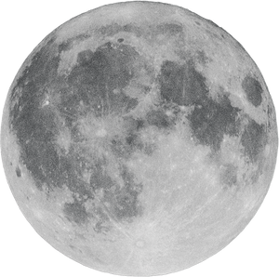

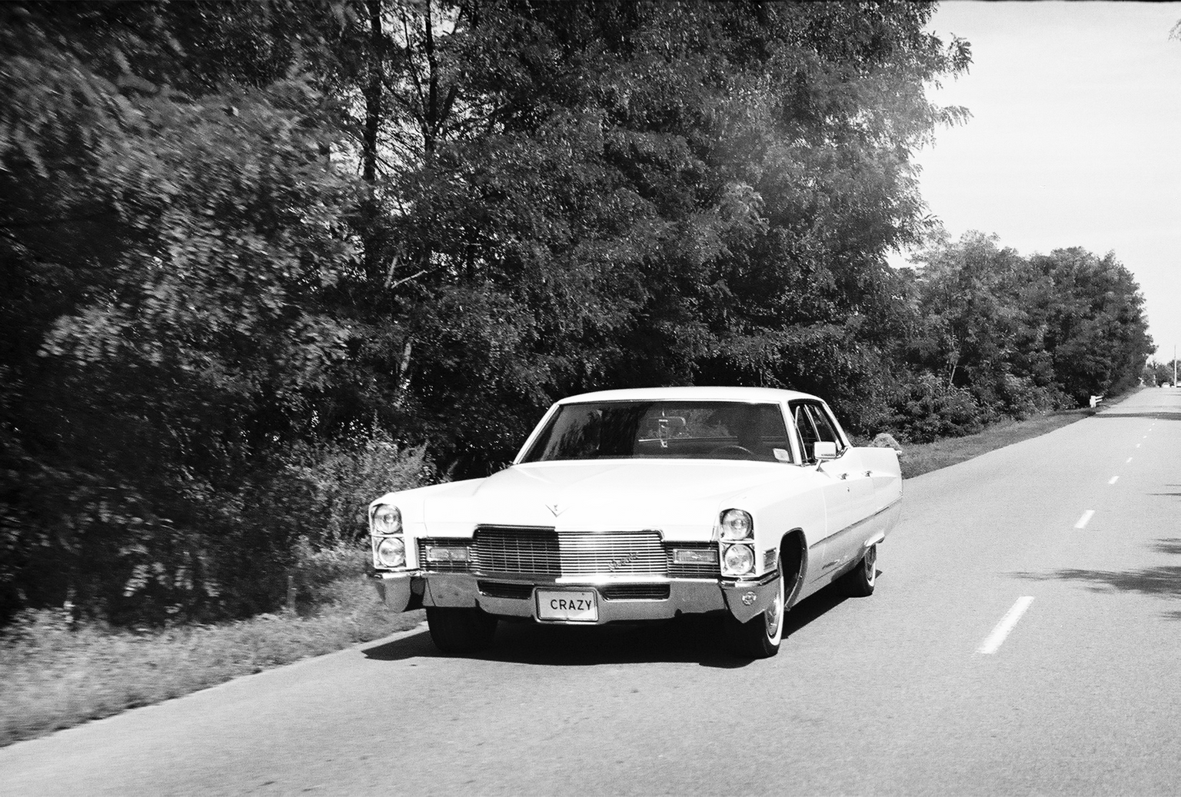



PR BLEM STATEMENT
THE RISE OF EVs
How to Navigate the Market in WA?
Notes:
How can established car manufacturing companies, seeking expansion in the electric vehicle (EV) sector or considering entry as newcomers, effectively strategize and navigate the dynamic EV market in the State of WA to ensure competitive advantage and long-term sustainability

Slide 4




DATASET
EV POPULATION DATA
DATASET
CLEAN DATASET
Data.gov.wa (Washington State Open Data Portal)
mydf.shape: (150482, 17)
mydf.keys(): 'VIN (1-10)', 'County', 'City', 'State', 'Postal Code', 'Model Year', 'Make', 'Model', 'Electric Vehicle Type', 'Clean Alternative Fuel Vehicle (CAFV) Eligibility', 'Electric Range', 'Base MSRP', 'Legislative District', 'DOL Vehicle ID', 'Vehicle Location', 'Electric Utility', '2020 Census Tract'
(1) EDF=mydf.dropna()
(2) EDF_ZeroRange=EDF[EDF['Electric Range']==0]
(3) EDF_ActualData = EDF[EDF['Electric Range']>0]
(4) EV_df=EDF_ActualData[EDF_ActualData['Electric Vehicle Type']=='Battery Electric Vehicle (BEV)’]
(5) EV_df.shape
(6) EV_df[['Electric Vehicle Type']].value_counts()

Slide 5
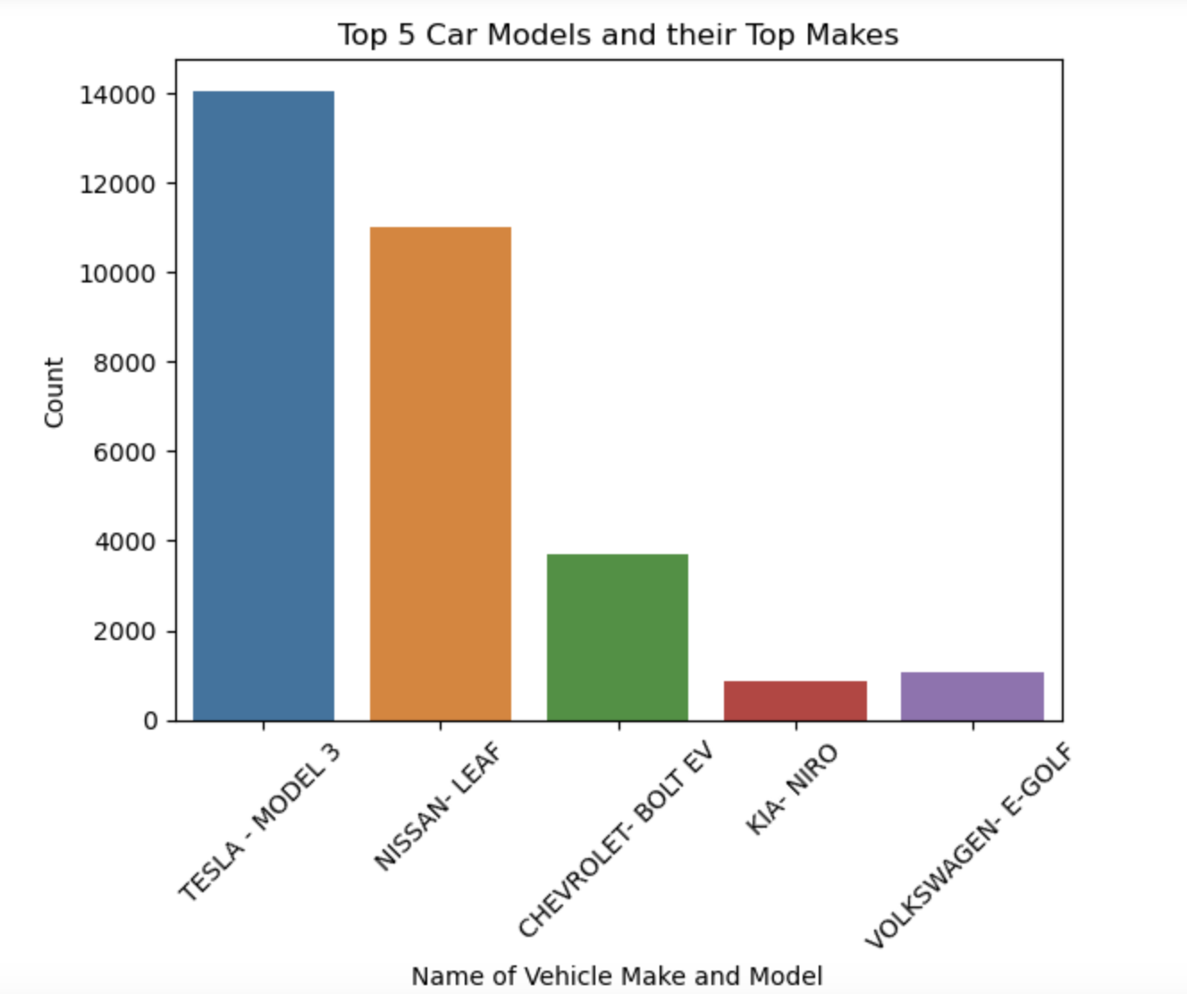
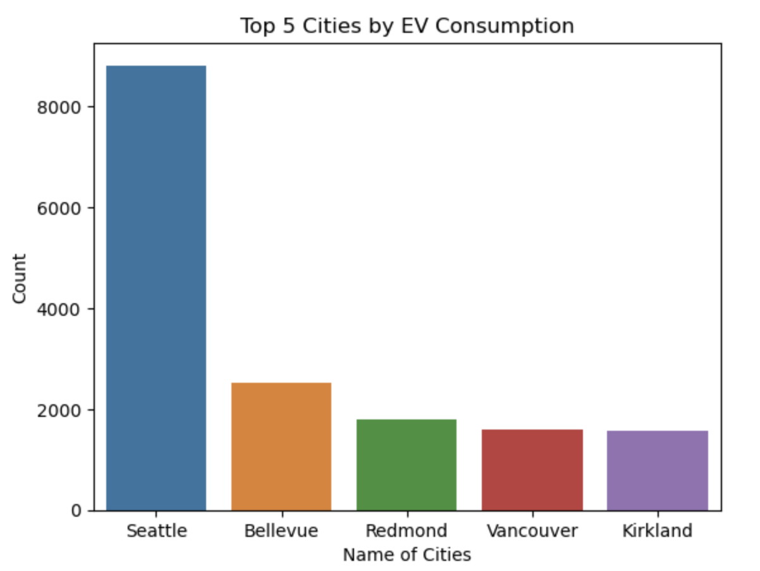

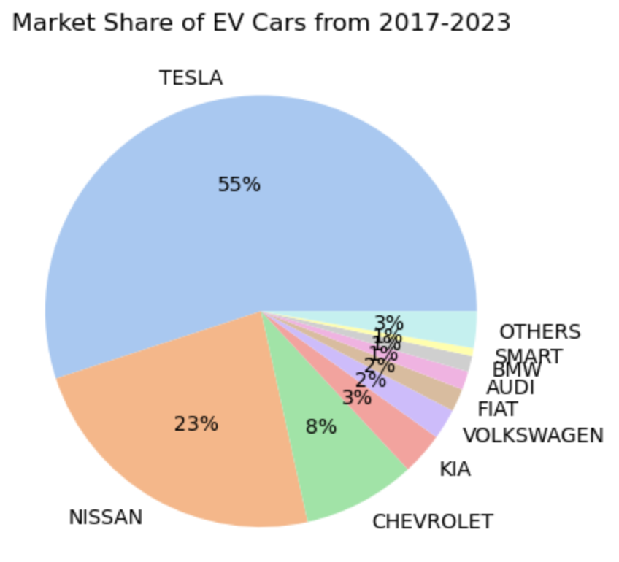



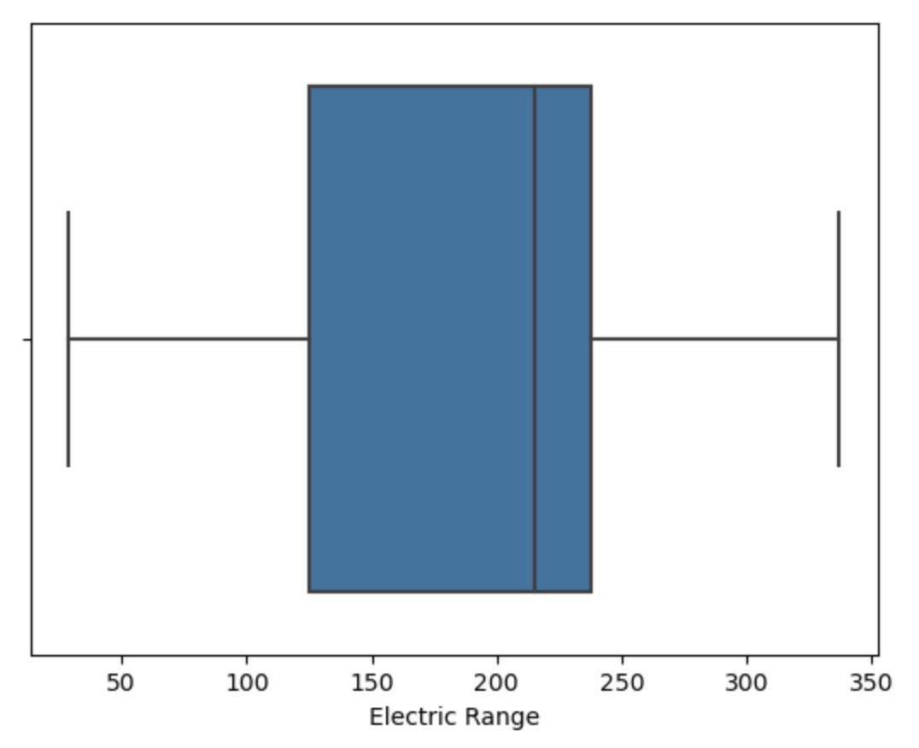


DATA
VISUALIZATIONS

Slide 6





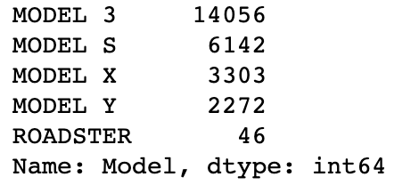
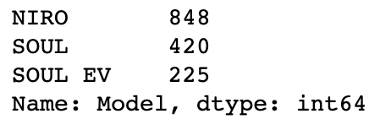
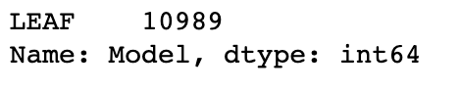
TESLA HOLDS 55%
NISSAN LEAF
2nd!
NIRO
FALLS
SHORT
EV_Tesla=EV_df[EV_df['Make']=='TESLA']
EV_Tesla['Model'].value_counts()
EV_Nissan=EV_df[EV_df['Make']=='NISSAN']
EV_Nissan['Model'].value_counts()
EV_Kia=EV_df[EV_df['Make']=='KIA']
EV_Kia['Model'].value_counts()

Slide 7
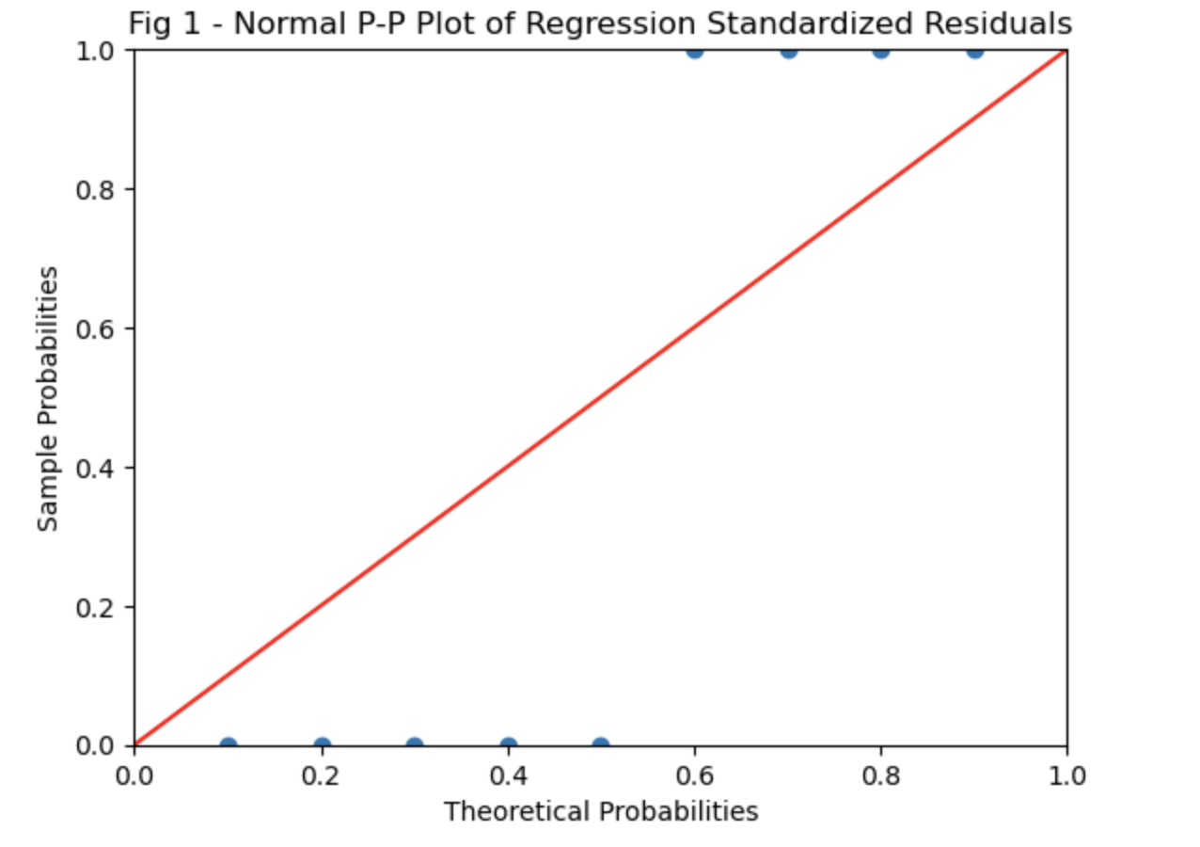
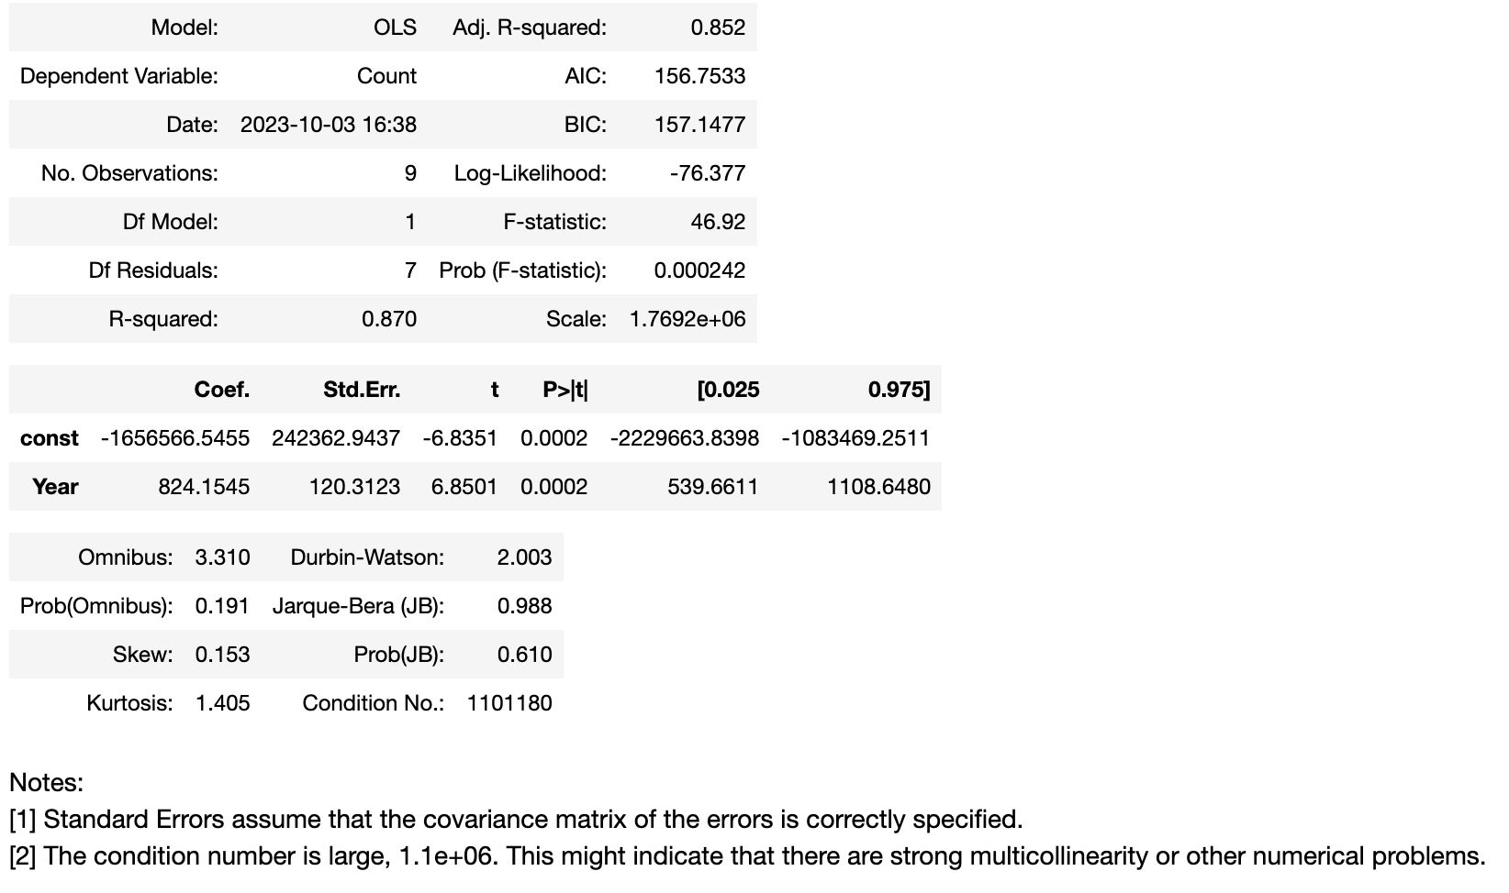
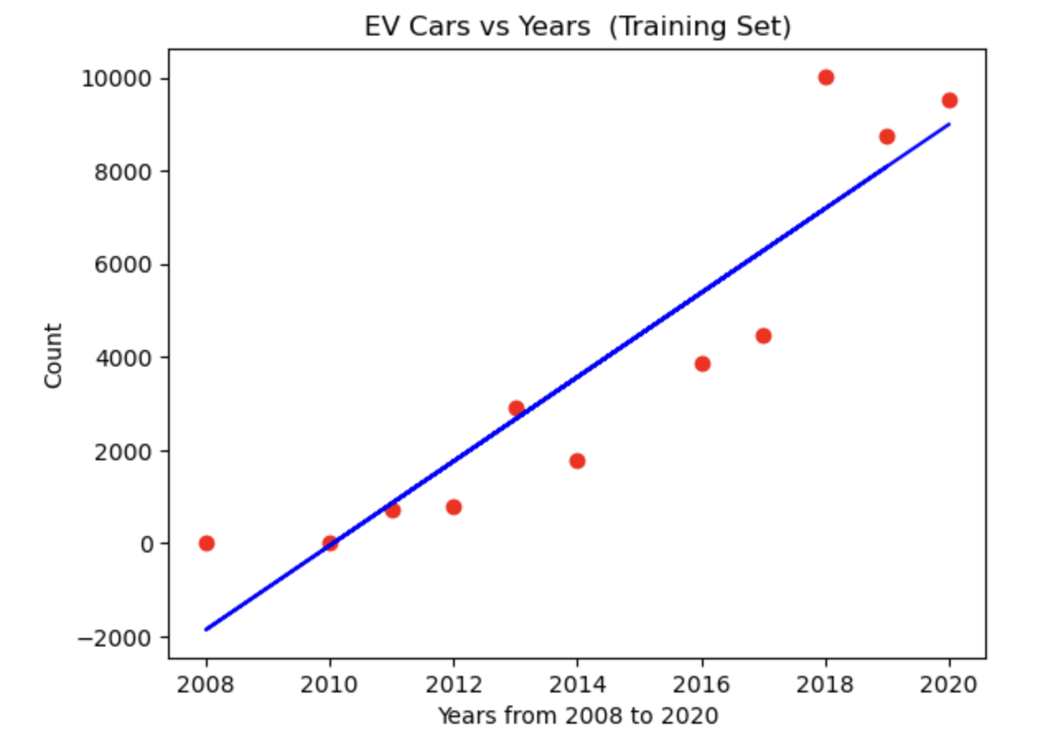
LINEAR
REGRESSION
y = 842x – 1,656,566
R-squared= 0.852

Slide 8
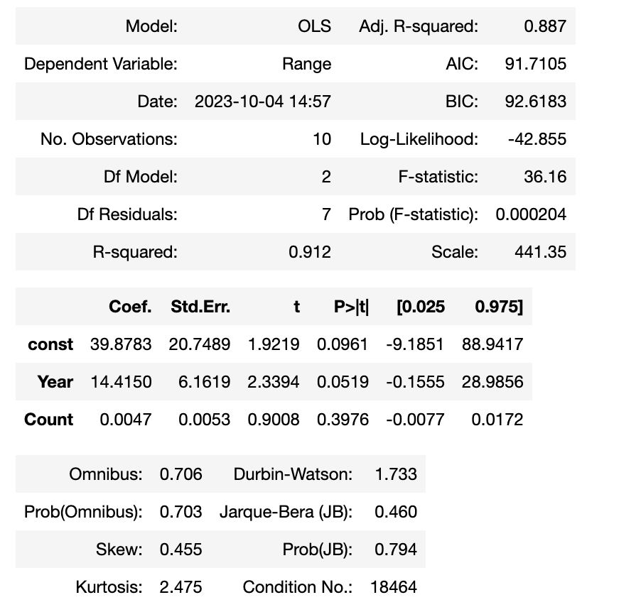
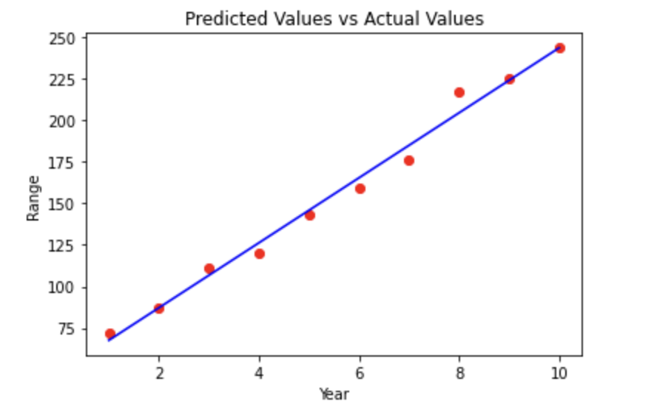
MULTI
REGRESSION

Slide 9





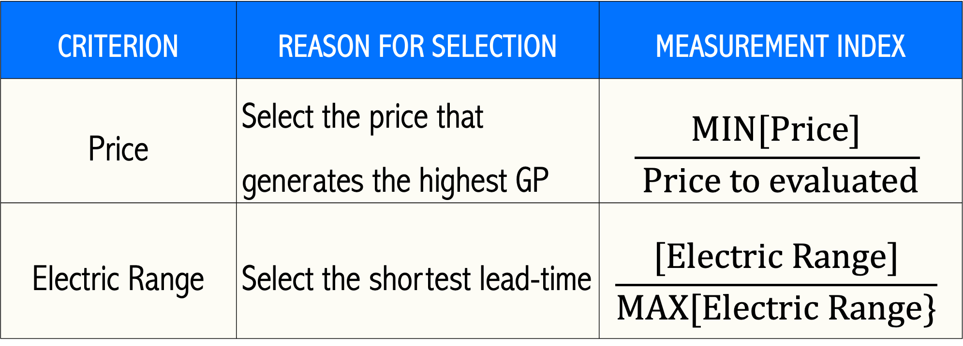
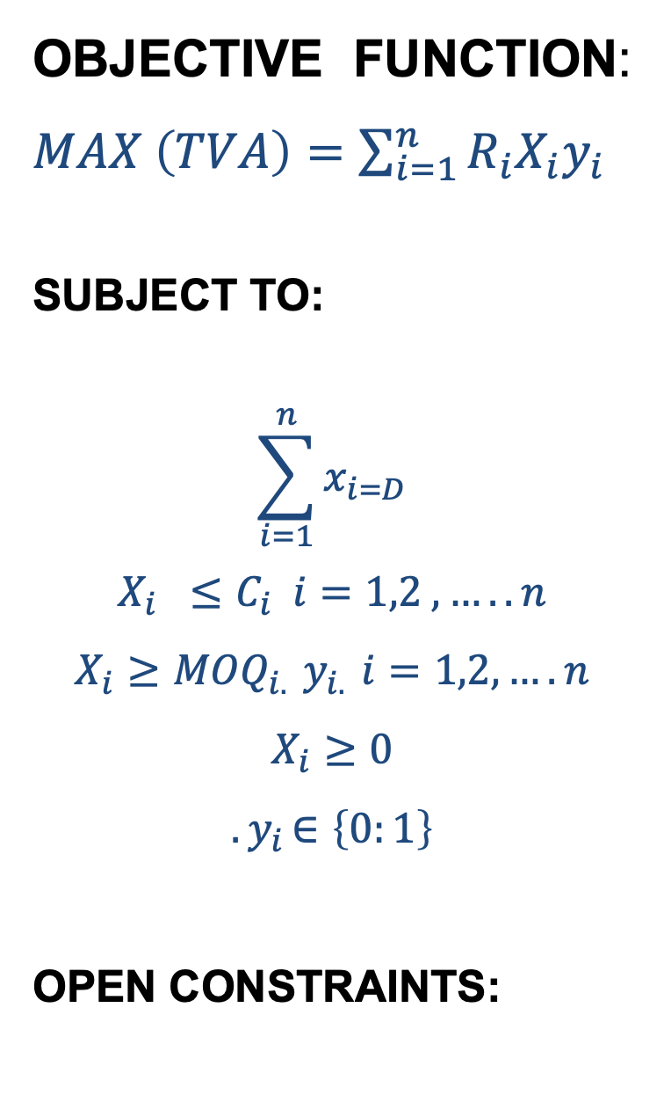
PTIMIZATI N
ACQUISTION VALUE
OBJECTIVE FUNCTION: $MAX \left(TVA\right)=\sum_{i=1}^{n}{R_{i}X_{i}y_{i}}$
SUBJECT TO:
$$\sum_{i=1}^{n}{x_{i=D}}$$
$$X_{i} ≤C_{i} i=1,2 ,…..n$$
$$X_{i}≥{MOQ}_{i. }y_{i. }i=1,2,….n$$
$$X_{i}≥0$$
$${.y}_{i}∈\left\{0:1\right\}$$
OPEN CONSTRAINTS:
CRITERION | REASON FOR SELECTION | MEASUREMENT INDEX
Price | Select the price that generates the highest GP | $$\frac{MIN[Price]}{ Price to evaluated}$$
Electric Range | Select the shortest lead-time | $$\frac{[Electric Range]}{MAX[Electric Range\}}$$
*Note: We consider Weighing for the Criteria in the Objective function
Capacity : If we have a fixed capacity per Car Brand/Make
Demand: If there is a Market Restrictions

Slide 10


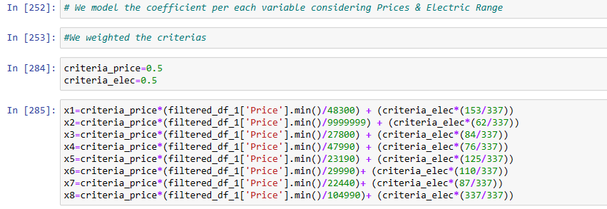
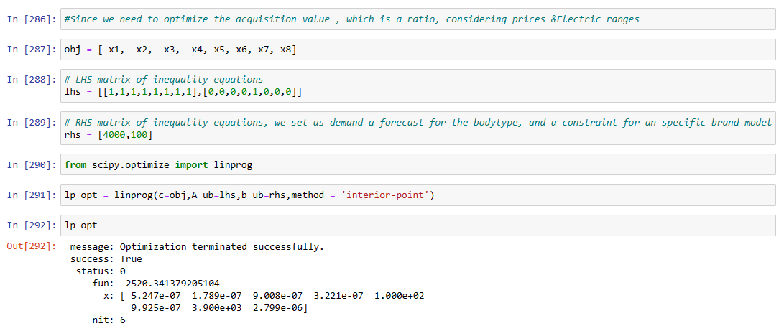


OPTIMIZATION MODEL

Slide 11


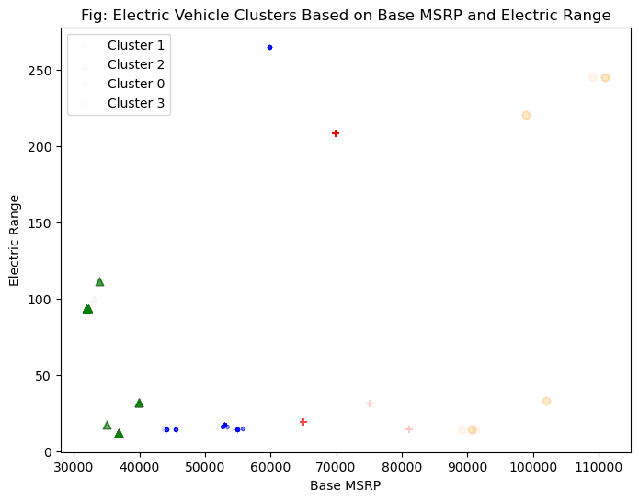

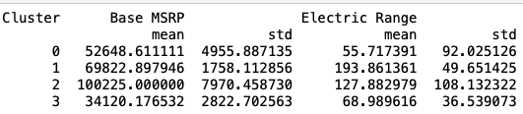


CLUSTERING
High variability in both ranges within clusters
Highly subjective – consider other variables (e.g. brand, reliability, reviews, utility)
Best overall value is in Cluster 1, relatively long range for price
Cluster 3 is least expensive and offers a longer range on average

Slide 12

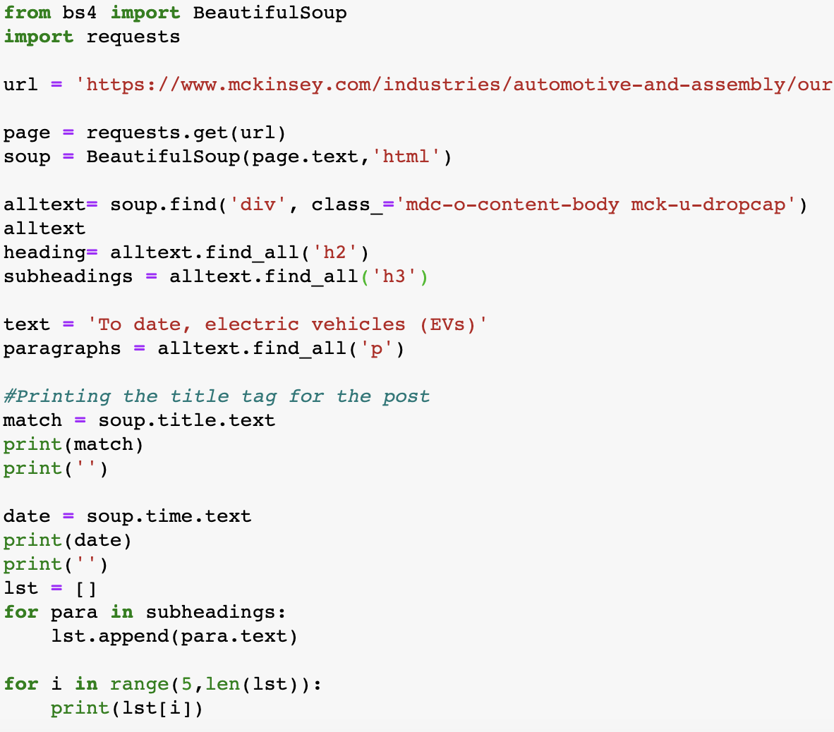
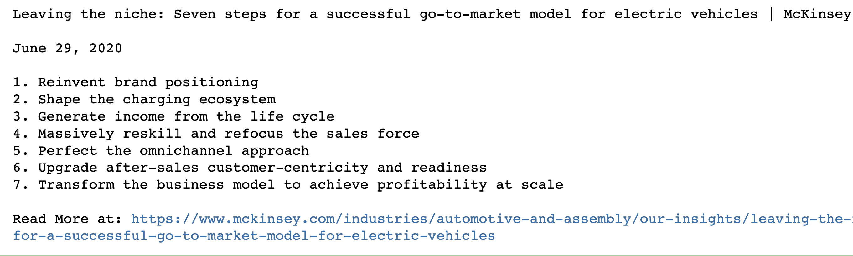
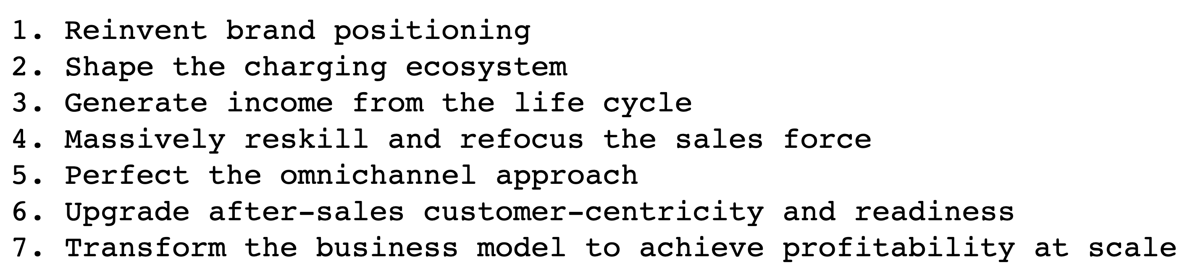
WEB SCRAPING
7 Steps for a Successful GTM Model
GTM model
Code:
7 Steps for a Successful GTM model
Results:

Slide 13






CITATIONS
data_m2.csv, cars_us_22.csv, ccarprice.com 2022/2023 new cars. validated web scrape by Tymoteusz Urban, WUT, Warsaw, Poland. https://www.kaggle.com/datasets/sidharth178/car-prices-dataset. Open Data Commons Open Database License.
Electric Vehicle Population Data. Washington State Department of Licensing, Research and Analysis Office (Updated September 14, 2023), https://data.wa.gov/Transportation/Electric-Vehicle-Population-Data/f6w7-q2d2. Open Data Commons Open Database License.

Slide 14
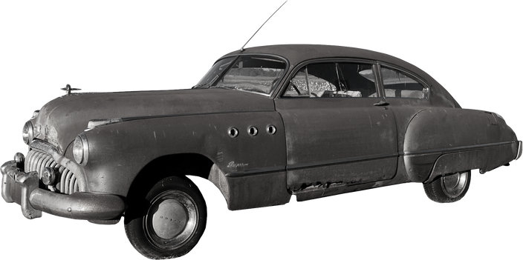
THANK
YOU!

